Slide 1

Analysis of customer spend and Product-Category level Engagement
By: Kratika Sharma

Slide 2










TABLE OF CONTENTS
PROBLEM STATEMENT AND SIGNIFICANCE
DATA INTRODUCTION
DATA CLEANING
DATA ANALYSIS AND MODELLING
MARKETING IMPLICATIONS

Slide 3



Problem Statement
What household demographic factors contribute most to customer spend in the stores?
What category is each customer most engaged with?

Slide 4

SIGNIFICANCE OF STUDY
Understand better as to what factors impact the amount of purchase customers make inside stores.
Design better targeted marketing campaigns powered by the knowledge of customer engagement (and spending) levels with various product categories

Slide 5


Available Data
Transaction level data of two years from 2,500 households who frequently shop at the client’s stores
Purchases made across the entire gamut of product categories available at the retailer’s stores
We have customer demographics data and direct marketing campaigns data available for certain households

Slide 6
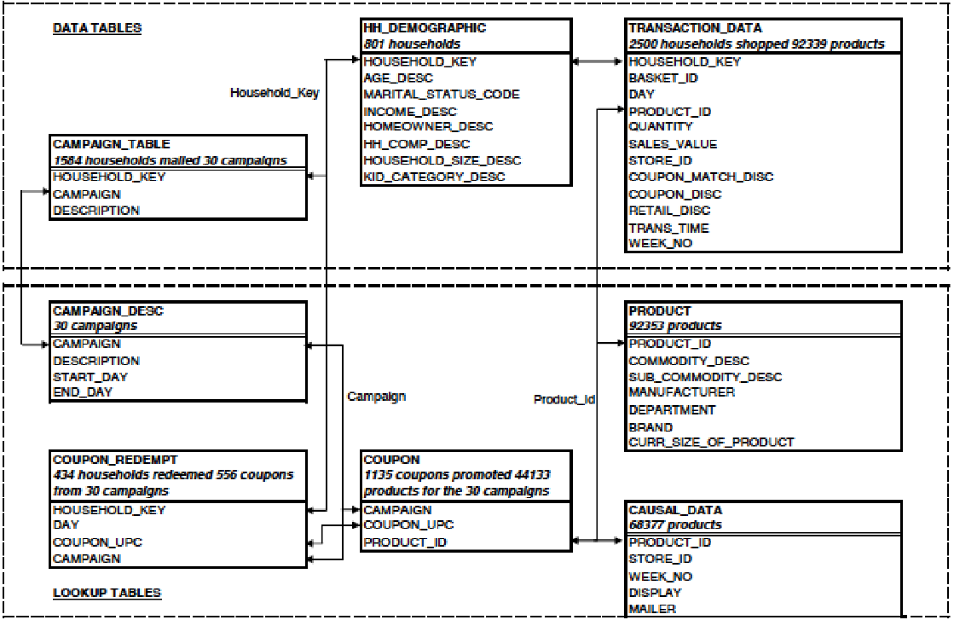

Slide 7

Tables Used for our analysis
For solving our two research questions the tables that contain variables of interest would be –
Transaction data
Demographics data
Product data

Slide 8
DATA CLEANING
Select relevant data
Handle Outliers
Correct data formats
Handle missing values/invalid data
Check for duplication
Merge data

Slide 9
What household demographic factors contribute most to customer spend in the stores?

Slide 10

Problem 1: Predictors and Response
income_desc (Income range): categorical variable
marrital_status_code (marital status) : categorical variable
age_desc (age range): categorical variable
household_size_desc ( household size): categorical variable
Total Sales: calculated from sales_value

Slide 11
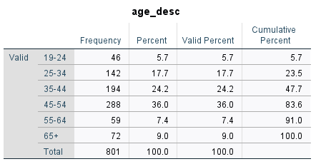
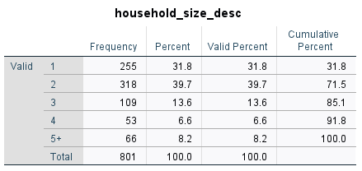
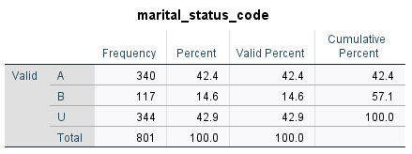
Descriptive Statistics
Out of 801 customers, 36% are in age group 45-54, 24.2% in 35-44, 17.7% in 25-34, 5.7% in 19-24, 7.4% in 55-64, and 9% above 65 years of age.
Out of 801 customers, 31.8% has household of size 1, 39.7% has household size of 2, 13.6% has household size of 3, 6.6% has household size 4, and 8.2% has household size of 5 and more.
Out of 801 customers, 42.4% are married, 14.6% are unmarried, and the status of 42.9% is unknown.

Slide 12
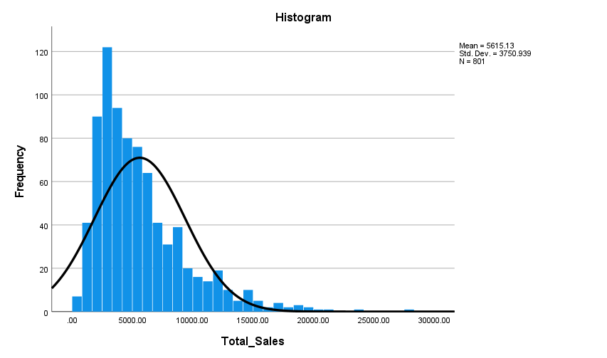
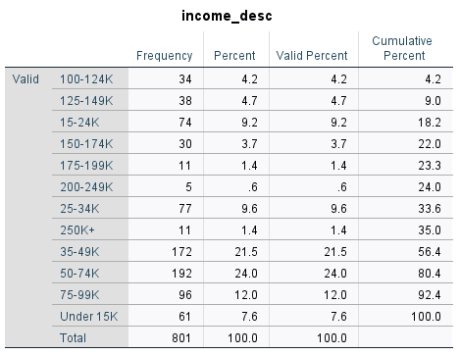
Total money spend is seen to follow a normal distribution with right skewedness. There are more people seen spending between 5000-15000.
Out of 801 customers, following is the percentage of people in different income groups:
Under 15K: 7.6%
15-24K: 9.2%
25-34K: 9.6%
35-49K: 21.5%
50-74K: 24%
75-99K: 12%
100-124K: 4.2%
125-149K: 4.7%
150-174K: 3.7%
175-199K: 1.4%
200-249K: 0.6%
250K+: 1.4%

Slide 13
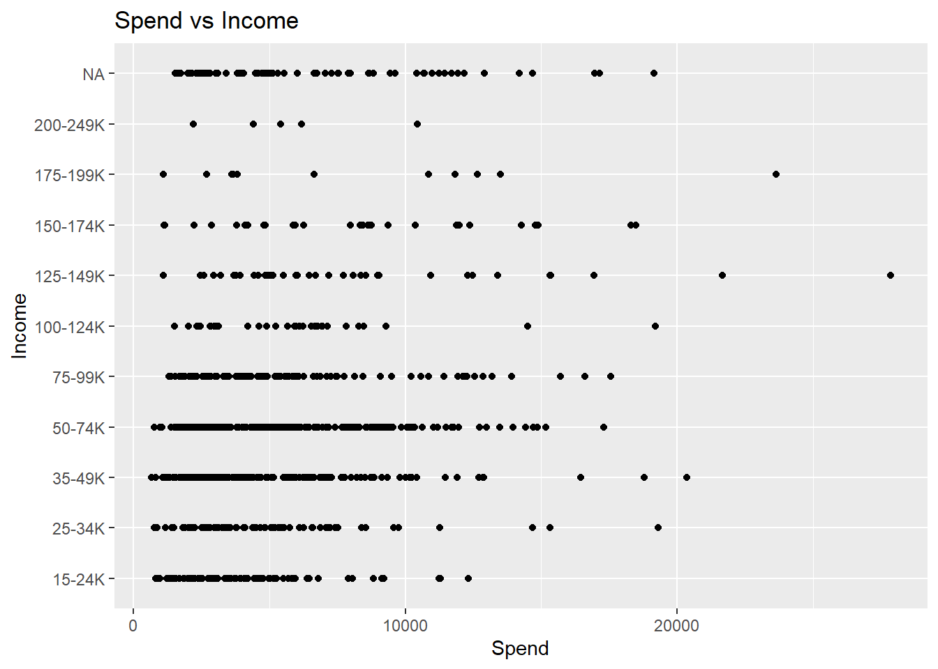
Analysis: Spend vs Income
We see that the average consumer spend looks to be the highest in the group of $50-74k followed by the groups of $35-49k and $75-99k.

Slide 14
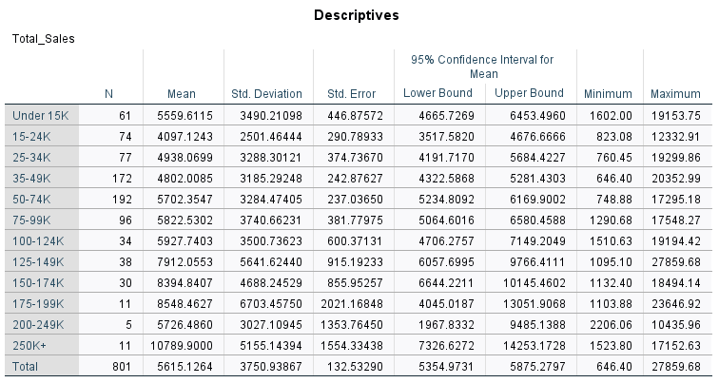
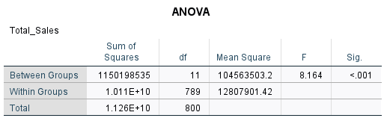
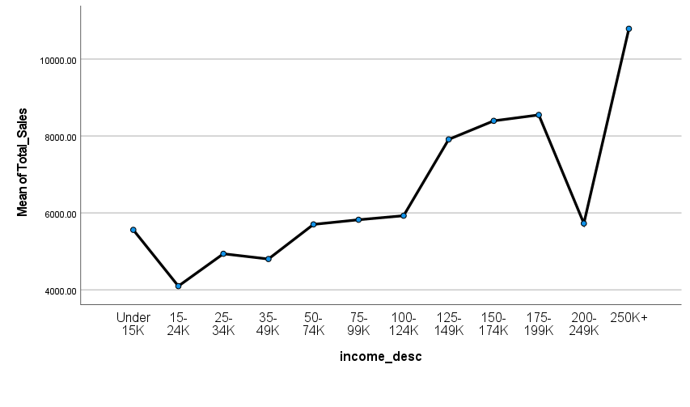
ANOVA: Comparing spend for different income groups
The sig. of Spend between the different income groups is <0.001, which is less than 0.005 and so we can say that there is difference in average spend in each income group.

Slide 15
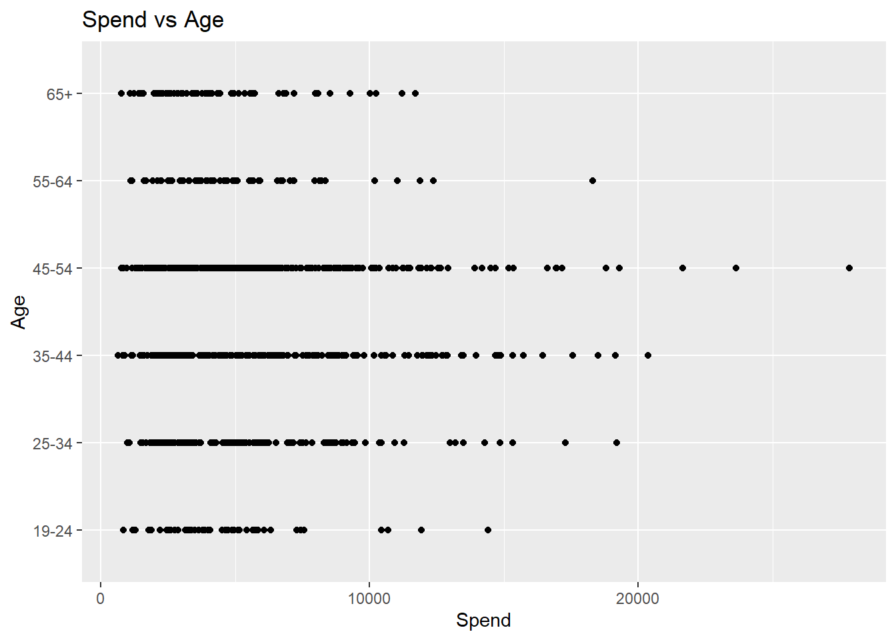
Analysis: Spend vs Age
It appears that the age bracket of 35-55 years spends the highest compared to all other age groups.

Slide 16
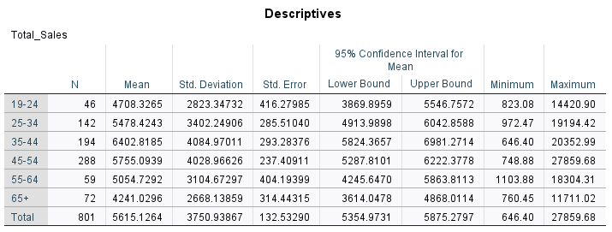
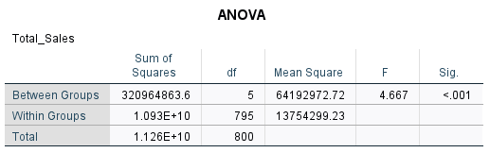
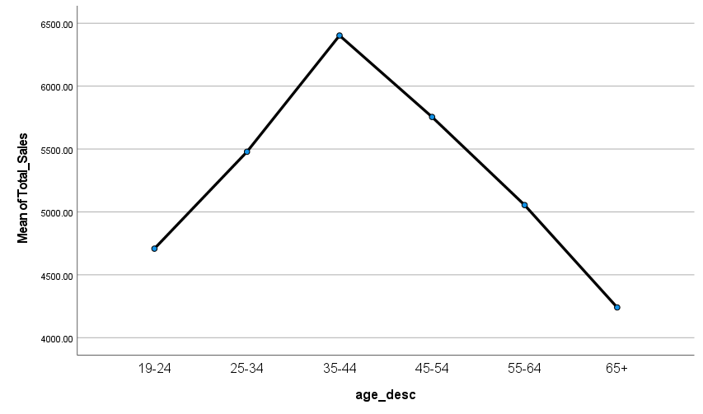
ANOVA: Comparing spend for different age groups
The sig. of Spend between the different age groups is <0.001, which is less than 0.005 and so we can say that there is difference in average spend in each age group. With 35-44 age group having the highest mean of spend.

Slide 17
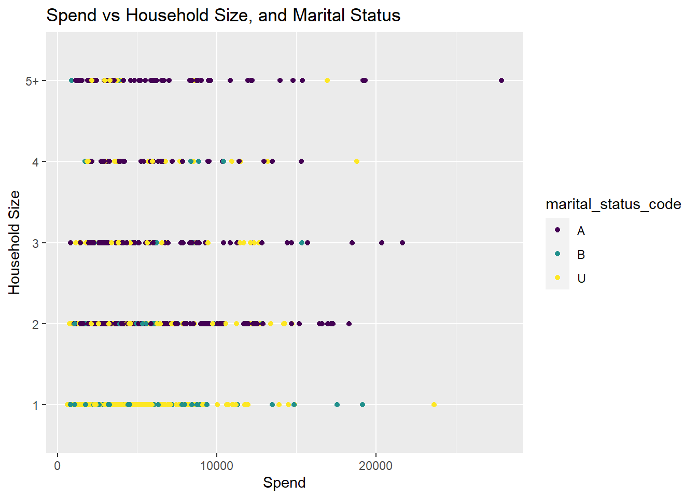
Analysis: Spend vs Household Size and Marital Status
It appears that households with sizes of 2 and 3 would be the highest average spenders, followed by households with sizes 1 and 5.
Moreover, it also appears that on average, married customers do spend more as compared to unmarried and single people.

Slide 18

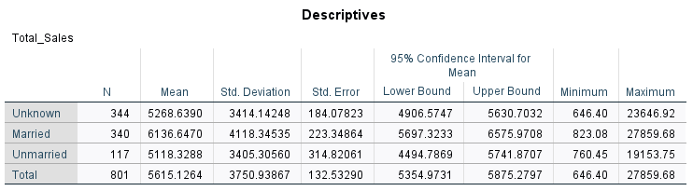
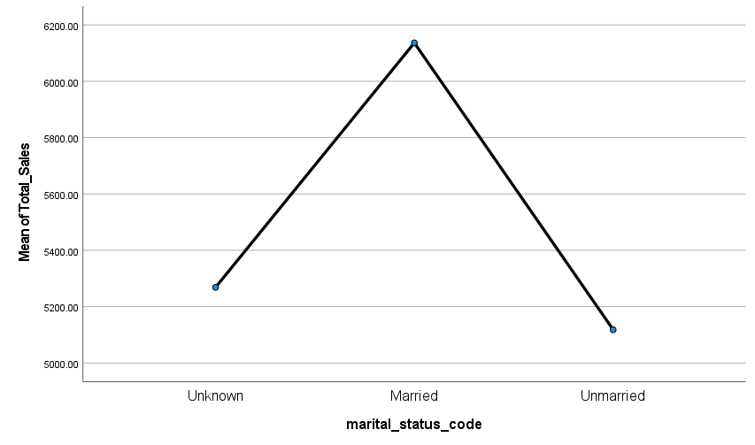
ANOVA: Comparing spend for different marital status groups
The sig. of Spend between the different marital status groups is 0.003, which is less than 0.005 and so we can say that there is difference in average spend in different marital status. With married people having the highest mean of spend.

Slide 19
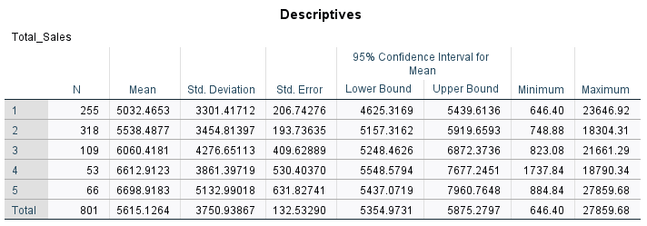
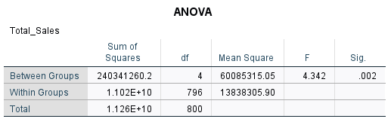
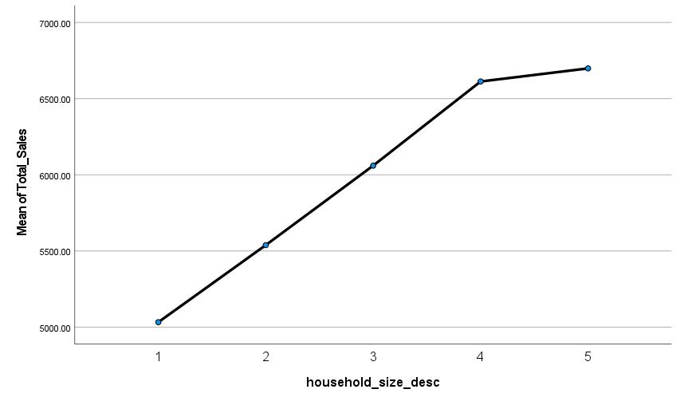
ANOVA: Comparing spend for different household size groups
The sig. of Spend between the different household size groups is 0.002, which is less than 0.005 and so we can say that there is difference in average spend in different household size.

Slide 20
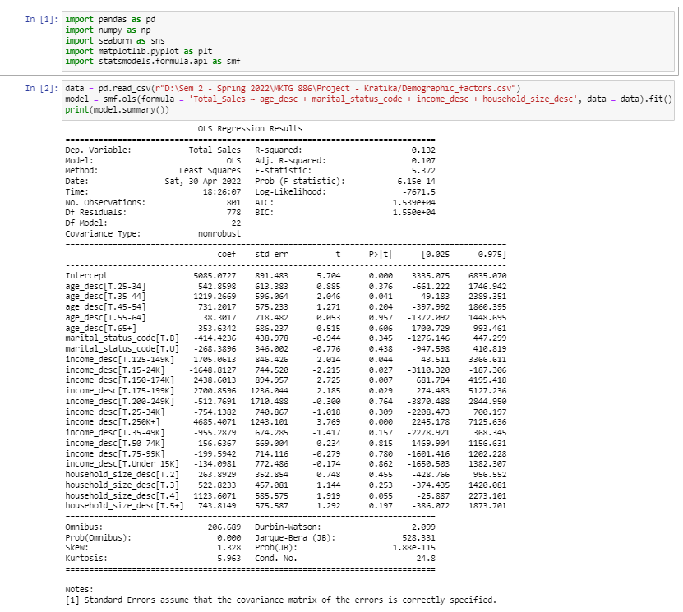
Modelling
Linear Regression Model -
Step 1-Data was collated with all the demographic variables and overall sales over a certain time period for all customers
Step 2-After checking relationships of variables with overall sales, we tested appropriateness for normality of the response variable. And we followed a dummy encoding for all the factor predictor variables.
Step 3-Once these validations were complete, we ran the linear regression to calculate estimates for each of the variables and categories
Step 4-Compare the model iteration using model-fit statistics(R-square, error) to arrive at the best model
Step 5-Calculate the contribution values to understand to what magnitude is sales affected by each of those demographic factors.

Slide 21
Interpretation
Our linear model results seem to match our initial conjecture to a great extent.
Age group 35-44 comes out to be statistically significant. Which means that a positive indicator in this age group could have a significant effect on the consumer spend.
Marital status ‘Married’ shows statistical significance which has the value of the intercept 5244. Which shows that a positive indicator in this category has a significant effect on consumer spend.
Income categories “15-24k”, “35-49k” and “50-74k” show statistical significance. With all else constant, a positive indicator in these categories will have a positive effect (combined with the intercept) on the consumer spend.
Household sizes 4 have some statistical significance in the model. Which means these have a significant effect on the consumer spend.
Total_Sales^ = b0 + b1*age(25-34) + b2* age(35-44) + b3* age(45-54) + b4* age(55-64) + b5* age(65+) + b6*marital_status_code_B+b7* marital_status_code_U +b8*household_size_2+ b9*household_size_3 + b10*household_size_4 + b11*household_size_5 + b12_income_desc(125-149K) + b13_income_desc(15-24K) + b14_income_desc(150-174K) + b15_income_desc(175-199K) + b16_income_desc(200-249K) + b17_income_desc(25-34K) + b18_income_desc(250K+) + b19_income_desc(35-49K) + b20_income_desc(50-74K) + b21_income_desc(75-99K) + b22_income_desc(Under 15K)

Slide 22
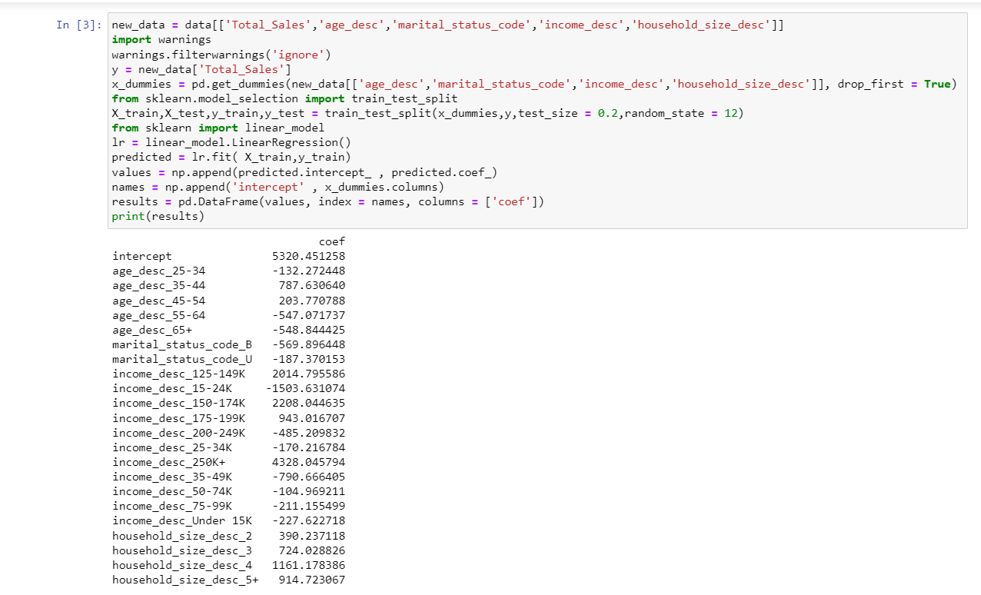
Splitting Data in Test and Train

Slide 23
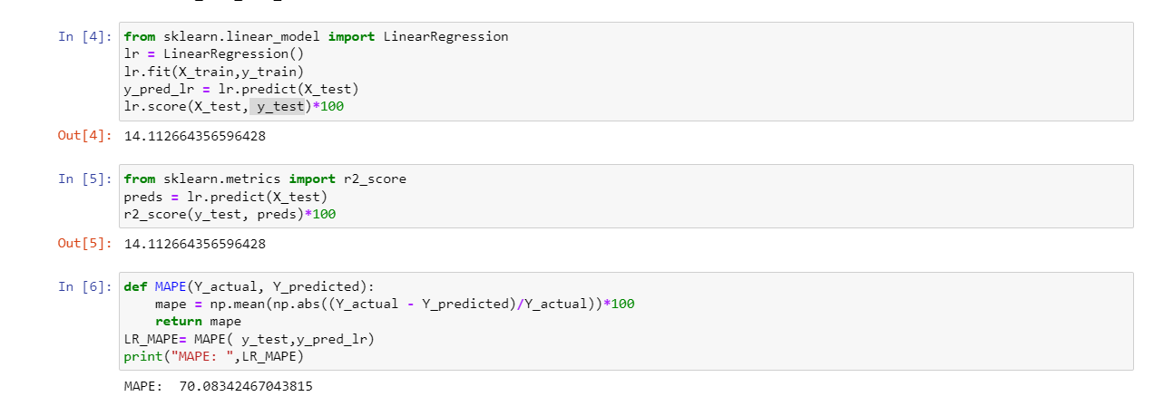
Accuracy and MAPE on Test data
Adjusted R-square is 14.1%, so we can say that 14.1% variability in Y is explained by variation in X variables
MAPE is 70.08%. So, predicted total sales deviates (on average) from the actual sales by 70.08.
The residuals of the total sales predicted from model is very high leading to the high MAPE
This is may because we have some variables which are not significant statistically present in the model or some variables which should also be considered

Slide 24
Problem 1: Summary And Marketing Implication
Overall, we find that of the four predictor variables studied there are a few categories in each that can largely influence the consumer spend.
Project Implications:
The insight on what demographics make consumers spend more will be key to any decision-making for this retail client.
This can be a big enabler in any promotion/coupon targeting programs to various consumer segments or to attract those demographic segments of consumers who currently are not high spenders.
Overall, we believe this knowledge is key to ensuring a high average customer lifetime value.
Limitations of the analysis * This study was limited to the demographic factors we saw in the data. when we ran the regression, we found it gave a lower R-square value. We think that there could be other predictor variables that we are not seeing in the data, which might help explain the correlation even better. Variables such as, whether the consumer is a loyal to another retail chain, or whether distance and convenience is a factor how people choose to walk into stores.

Slide 25
Segmenting customer based on spend across product category

Slide 26
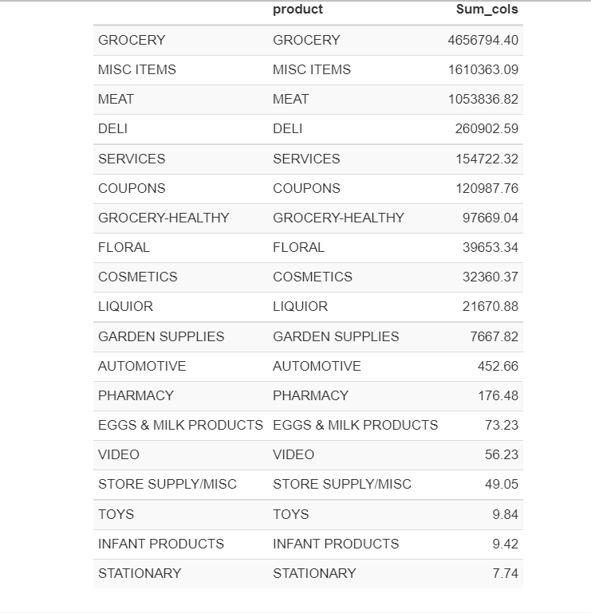
Problem 2: Segmenting customer based on spend across product category
Total sales across product category suggests that biggest product category is Grocery followed by Misc Items and Meat.
These 19 variables were taken as input for K-means clustering
Here in this excel, we can find all the different customer segments

Slide 27
Insights from analysis
Among the high spenders, there is a segment ‘H-Floral-Cosmetics-Garden Suplies buyers’ with 67 households and it seems to be buying products from floral, cosmetics and garden supplies.
We can target this segment using cross-category promotions across these product categories to increase their engagement level. Also, in case sales of any of these product categories is dropping, sales across this customer segment should be checked for any potential reasons.
Majority of the customers(~1230) belong to the “VL-Grocery-Basic Necessities” segment who visit stores for the necessities (groceries/basic necessities)
Majority of the money is spent on buying on grocery(~61%) followed by Misc Items(17%) and meat(14%)
Another important segment is “L-Broad category Spenders” with 639 customers. These customers spend on broad categories ranging from Grocery, Deli, Meat , Services and coupons to less common

Slide 28
Problem 2: Marketing Implications
Earlier promotions were sent out to household without much consideration of customer/household profile and the buying potential.
So, the promotions were not customized for the audience and were sent to all irrespective of their preferences.
New segmentation exercise would allow business to send targeted messages and enable them to design promotional strategies in a better way.
Also, knowing how your sales is distributed across categories will allow stores to come up with cross-category promotions aimed at increasing customer spend.

